Slide 1
Airport Flight Database
Final Progress Update
Flight Information Display System (F.I.D.S.).
Luke - Front end dev
Benton - Back end dev
P.J. - Both + Documentation
Notes:
Airport Flight Database - luke

Slide 2

Description and motivation
We made a real-time flight tracker for airport terminal kiosks and online passengers
We wanted to make something that would run on a airport arrivals and departures kiosk
Luke
Notes:
luke

Slide 3
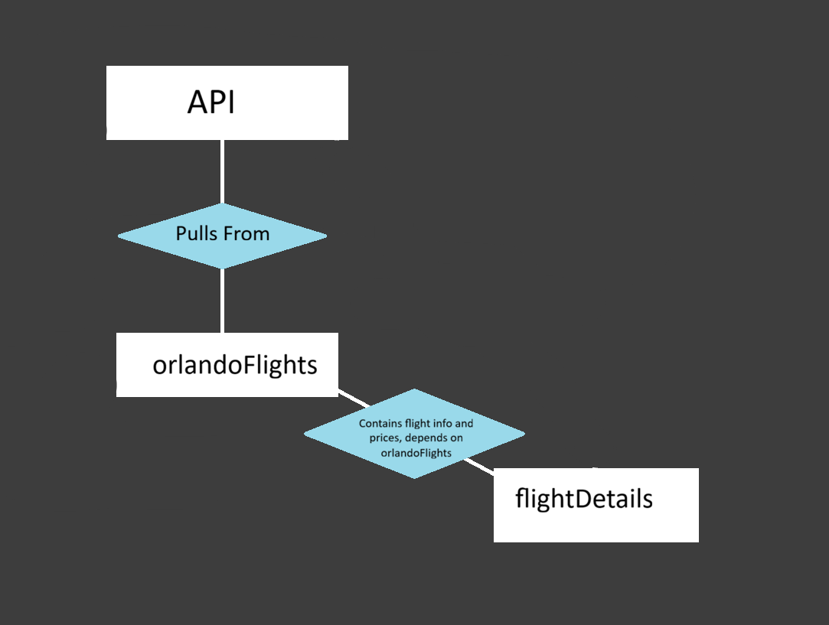
ER Diagram
Benton
Notes:
benton

Slide 4


Relations and Schema
orlandoFlights
Flight Number (Primary)
Airline
From
To
Departure
Arrival
Duration
Gate
Terminal
Aircraft (ICAO)
Status
\
Benton
Notes:
Kill tarantino benton

Slide 5
Relations and Schema (cont.)
flightDetails
Flight Number (Primary)
Airline
Status
Departure
Arrival
Gate
Terminal
Aircraft
Prices
\
Benton
Notes:
Kill tarantino benton

Slide 6
Timeline
Week 1: Database
Week 2: Front End
Week 3: Debugging
Week 5: Decide to rework database, brainstorming how to do that
Week 6: Connecting live database to our site
Week 7: Front end for new parts
Week 8: Work on presentation
Luke
Notes:
luke

Slide 7
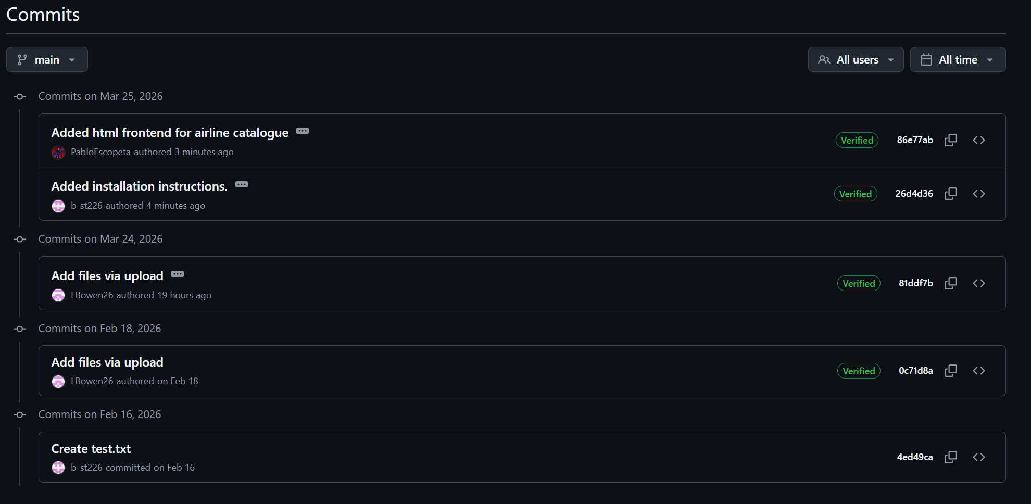
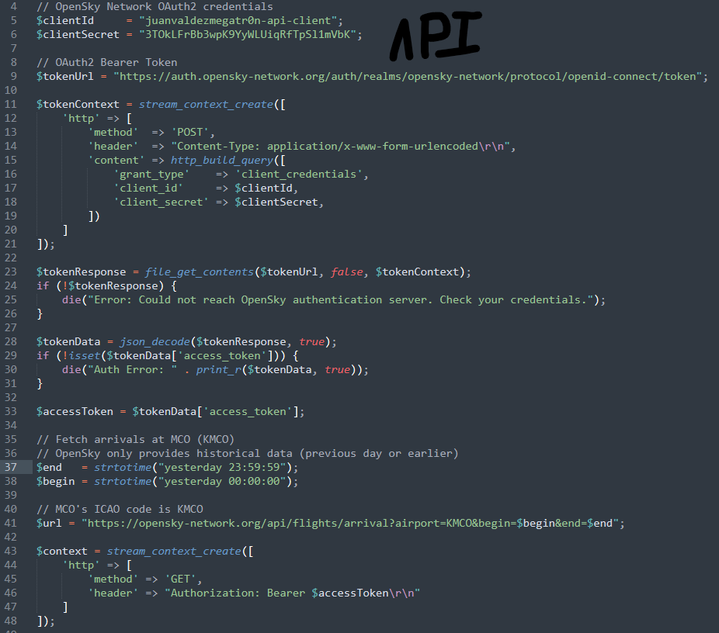
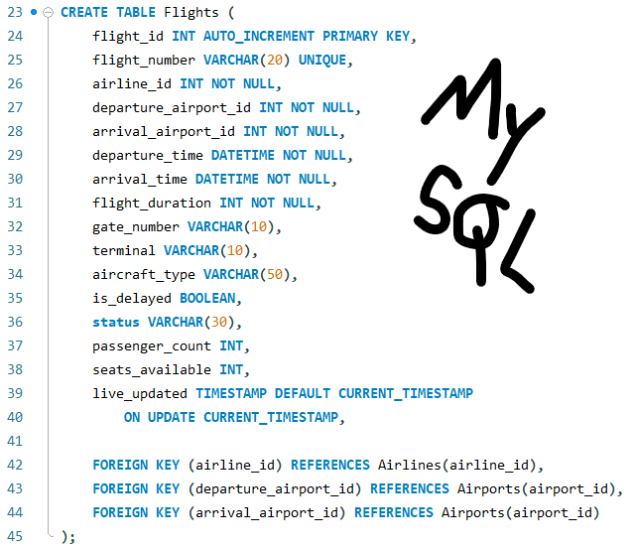
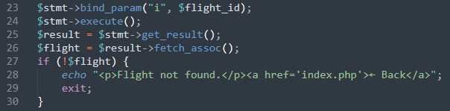
Code Snippets
sync_flights.php
flight_data.sql
PJ
flight_details.php
Notes:
PJ
NOT NULL == col cannot accept null value
MYSQL == table relation
API == API calling & Integration
Flight_details == how we call the API’s data into flight_details relation

Slide 8

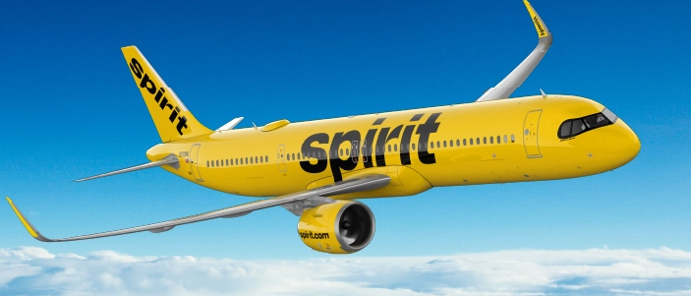


DEMO
https://github.com/LBowen26/CMS375-Spring2026
Apologies in advance if PJ goes on a rant about Spirit Airlines
== Doodoo
PJ
Notes:
TLDR: flight information display system (F.I.D.S.) is pretty cool & efficient for helping people get to where they need to go.
PJ

Slide 9
Challenges and solutions
Communication and scheduling
Solved by giving clear tasks for each person that can be done asynchronously
Getting a live API dataset that updates
Purchased a subscription to aviation stack to get our flight data
Changing our project to accept the new dataset
Sacrifices to Baal
Luke
Notes:
TLDR: flight information display system (F.I.D.S.) is pretty cool & efficient for helping people get to where they need to go.
Luke

Slide 10


Challenges and solutions
The feds
Solution:
24-Hour Delay
Aviationstack limited to 3 independent calls at once
Switch to OpenSky
Luke
Notes:
TLDR: flight information display system (F.I.D.S.) is pretty cool & efficient for helping people get to where they need to go.
Luke

Slide 11
Future Improvements
Make a custom api that does not require an external subscription
Add no fly list
Add interactive map that shows flight progress in real time
Build a demo kiosk for presentation purposes
Add a way for pilots to log in and say they are running late
Add a way to get assistance from the airline or an AI assistant
Benton
Notes:
TLDR: flight information display system (F.I.D.S.) is pretty cool & efficient for helping people get to where they need to go.
Benton

Slide 12

Individual Contribution
Luke
Made original dataset
Front end development
Powerpoint contribution
Benton
Researched potential live API implementation
Powerpoint contribution
Outlined installation instructions
PJ
API implementation
Backend development
Debugging
Burning Hatred for Spirit Airl Airlines
Notes:
TLDR: flight information display system (F.I.D.S.) is pretty cool & efficient for helping people get to where they need to go.

Slide 13
API Credit
Matthias Schäfer, Martin Strohmeier, Vincent Lenders, Ivan Martinovic, and Matthias Wilhelm.
"Bringing Up OpenSky: A Large-scale ADS-B Sensor Network for Research".
In Proceedings of the 13th IEEE/ACM International Symposium on Information Processing in Sensor Networks (IPSN), pages 83-94, April 2014.

Slide 14
END
Or is it?
Year
Notes:
END

